Slide 1
Algorithms and Data Structures - Part II
SORTING AND SEARCHING ARRAY DATA

Slide 2

Measuring Performance
Array sorting algorithms
Overview
Selection sort
Bubble sort
Insertion sort
Merge sort
Quick sort
Searching array data
Linear search
Binary search
Exponential search
Assisted Practice: Algorithm implementation

Slide 3
What Is Sorting?

Slide 4
Sorting Array Data
6 | 4 | 3 | 7 | 5 | 4 | 8

Slide 5
Sorting Array Data
6
7
4
4
8
3
5

Slide 6
Sorting Array Data
6
7
3 | 4 | 4
8
5

Slide 7
Sorting Array Data
7
3 | 4 | 4 | 5 | 6
8

Slide 8
Sorting Array Data
3 | 4 | 4 | 5 | 6 | 7 | 8

Slide 9
Sorting Array Data
3 | 4 | 4 | 5 | 6 | 7 | 8

Slide 10
Measuring Performance

Slide 11


Measuring Performance
Comparisons
When two values in the array being sorted are compared for relative equality
Swaps
When two values in the array being sorted exchange places

Slide 12



Measuring Performance
Comparisons and swaps are expressed using Big-O notation
The actual cost of either operation depends on multiple factors
Reducing either operation can improve performance

Slide 13
Sorting Algorithms

Slide 14
Bubble Sort

Slide 15



Bubble Sort
Iterate
Visit each item in the array from the start to the end
Swap
If two neighboring items are out of order, swap them
Repeat Repeat this process
until the array is sorted

Slide 16
Bubble Sort
1 | 3 | 4 | 7 | 5 | 4 | 8

Slide 17
Bubble Sort
Pass 1
1 | 3 | 4 | 7 | 5 | 4 | 8

Slide 18
Bubble Sort
Pass 1
1 | 3 | 4 | 7 | 5 | 4 | 8
For each item

Slide 19
Bubble Sort
Pass 1
1 | 3 | 4 | 7 | 5 | 4 | 8
For each item
Compare to next
1 < 3

Slide 20
Bubble Sort
Pass 1
1 | 3 | 4 | 7 | 5 | 4 | 8
For each item
Compare to next Swap if greater
1 < 3

Slide 21
Bubble Sort
Pass 1
1 | 3 | 4 | 7 | 5 | 4 | 8
For each item
Compare to next Swap if greater Continue to end
3 < 4

Slide 22
Bubble Sort
Pass 1
1 | 3 | 4 | 7 | 5 | 4 | 8
For each item
Compare to next Swap if greater Continue to end
4 < 7

Slide 23
Bubble Sort
Pass 1
1 | 3 | 4 | 7 | 5 | 4 | 8
For each item
Compare to next Swap if greater Continue to end
7 < 5

Slide 24
Bubble Sort
Pass 1
1 | 3 | 4 | 5 | 7 | 4 | 8
For each item
Compare to next Swap if greater Continue to end
7 < 4

Slide 25
Bubble Sort
Pass 1
1 | 3 | 4 | 5 | 4 | 7 | 8
For each item
Compare to next Swap if greater Continue to end
7 < 8

Slide 26
Bubble Sort
Pass 1
1 | 3 | 4 | 5 | 4 | 7 | 8
For each item
Compare to next Swap if greater Continue to end
Repeat until no swaps are performed
7 < 8

Slide 27
Bubble Sort
Pass 1
1 | 3 | 4 | 5 | 4 | 7 | 8
For each item
Compare to next Swap if greater Continue to end
Repeat until no swaps are performed
Pass 2
1 | 3 | 4 | 5 | 4 | 7 | 8
1 < 3

Slide 28
Bubble Sort
Pass 1
1 | 3 | 4 | 5 | 4 | 7 | 8
For each item
Compare to next Swap if greater Continue to end
Repeat until no swaps are performed
Pass 2
1 | 3 | 4 | 5 | 4 | 7 | 8
3 < 4

Slide 29
Bubble Sort
Pass 1
1 | 3 | 4 | 5 | 4 | 7 | 8
For each item
Compare to next Swap if greater Continue to end
Repeat until no swaps are performed
Pass 2
1 | 3 | 4 | 5 | 4 | 7 | 8
4 < 5

Slide 30
Bubble Sort
Pass 1
1 | 3 | 4 | 5 | 4 | 7 | 8
For each item
Compare to next Swap if greater Continue to end
Repeat until no swaps are performed
Pass 2
1 | 3 | 4 | 5 | 4 | 7 | 8
5 < 4

Slide 31
Bubble Sort
Pass 1
1 | 3 | 4 | 5 | 4 | 7 | 8
For each item
Compare to next Swap if greater Continue to end
Repeat until no swaps are performed
Pass 2
1 | 3 | 4 | 4 | 5 | 7 | 8
5 < 7

Slide 32
Bubble Sort
Pass 1
1 | 3 | 4 | 5 | 4 | 7 | 8
For each item
Compare to next Swap if greater Continue to end
Repeat until no swaps are performed
Pass 2
1 | 3 | 4 | 4 | 5 | 7 | 8
7 < 8

Slide 33
Bubble Sort
Pass 1
1 | 3 | 4 | 5 | 4 | 7 | 8
For each item
Compare to next Swap if greater Continue to end
Repeat until no swaps are performed
Pass 2
1 | 3 | 4 | 4 | 5 | 7 | 8
Pass 3
1 | 3 | 4 | 4 | 5 | 7 | 8

Slide 34
Bubble Sort
Pass 1
1 | 3 | 4 | 5 | 4 | 7 | 8
For each item
Compare to next Swap if greater Continue to end
Repeat until no swaps are performed
Pass 2
1 | 3 | 4 | 4 | 5 | 7 | 8
Pass 3
1 | 3 | 4 | 4 | 5 | 7 | 8

Slide 35
Bubble Sort
Pass 1
1 | 3 | 4 | 5 | 4 | 7 | 8
For each item
Compare to next Swap if greater Continue to end
Repeat until no swaps are performed
Pass 2
1 | 3 | 4 | 4 | 5 | 7 | 8
Pass 3
1 | 3 | 4 | 4 | 5 | 7 | 8

Slide 36



Bubble Sort Asymptotic Analysis
Best
O(n) comparisons and swaps
Average O(n²) comparisons
and swaps
Worst
O(n²) comparisons and swaps

Slide 37

Bubble Sort’s O(n²) average case makes it a poor general-purpose sorting algorithm

Slide 38

Assisted Practice
Bubble sort algorithm

Slide 39
Insertion Sort

Slide 40


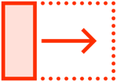
Insertion Sort
Iterate
Visit each item in the array from the start to the end
Compare
Find out of order neighboring items
Shift and Insert Find the insertion
point, shift, and insert

Slide 41
Insertion Sort
For each item
6 | 4 | 3 | 7 | 5 | 4 | 8

Slide 42
Insertion Sort
For each item
Compare to next
6 | 4 | 3 | 7 | 5 | 4 | 8
6 < 4

Slide 43
Insertion Sort
4
For each item
Compare to next Shift and insert
6
3 | 7 | 5 | 4 | 8
6 < 4

Slide 44
Insertion Sort
4
For each item
Compare to next Shift and insert
6 | 3 | 7 | 5 | 4 | 8
6 < 4

Slide 45
Insertion Sort
For each item
Compare to next Shift and insert
4 | 6 | 3 | 7 | 5 | 4 | 8
6 < 4

Slide 46
Insertion Sort
For each item
Compare to next Shift and insert Continue to end
4 | 6 | 3 | 7 | 5 | 4 | 8
6 < 3

Slide 47
Insertion Sort
3
For each item
Compare to next Shift and insert Continue to end
4
6
7 | 5 | 4 | 8
6 < 3

Slide 48
Insertion Sort
3
For each item
Compare to next Shift and insert Continue to end
4 | 6 | 7 | 5 | 4 | 8
6 < 3

Slide 49
Insertion Sort
For each item
Compare to next Shift and insert Continue to end
3 | 4 | 6 | 7 | 5 | 4 | 8
6 < 3

Slide 50
Insertion Sort
For each item
Compare to next Shift and insert Continue to end
3 | 4 | 6 | 7 | 5 | 4 | 8
6 < 7

Slide 51
Insertion Sort
For each item
Compare to next Shift and insert Continue to end
3 | 4 | 6 | 7 | 5 | 4 | 8
7 < 5

Slide 52
Insertion Sort
5
For each item
Compare to next Shift and insert Continue to end
3 | 4 | 6 | 7
4
8
7 < 5

Slide 53
Insertion Sort
5
For each item
Compare to next Shift and insert Continue to end
3
4
6 | 7 | 4 | 8
7 < 5

Slide 54
Insertion Sort
For each item
Compare to next Shift and insert Continue to end
3 | 4 | 5 | 6 | 7 | 4 | 8
7 < 5

Slide 55
Insertion Sort
For each item
Compare to next Shift and insert Continue to end
3 | 4 | 5 | 6 | 7 | 4 | 8
7 < 4

Slide 56
Insertion Sort
4
For each item
Compare to next Shift and insert Continue to end
3 | 4 | 5 | 6 | 7
8
7 < 4

Slide 57
Insertion Sort
4
For each item
Compare to next Shift and insert Continue to end
3
4
5 | 6 | 7 | 8
7 < 4

Slide 58
Insertion Sort
For each item
Compare to next Shift and insert Continue to end
3 | 4 | 4 | 5 | 6 | 7 | 8
7 < 4

Slide 59
Insertion Sort
For each item
Compare to next Shift and insert Continue to end
3 | 4 | 4 | 5 | 6 | 7 | 8
7 < 8

Slide 60
Insertion Sort
For each item
Compare to next Shift and insert Continue to end
3 | 4 | 4 | 5 | 6 | 7 | 8

Slide 61
Insertion Sort Asymptotic Analysis
Best
O(n) comparisons and swaps
Average O(n²) comparisons
and swaps
Worst
O(n²) comparisons and swaps

Slide 62
Despite it’s O(n²) average case, Insertion Sort can be useful in specific cases

Slide 63



Insertion Sort Use Cases
Adaptive
Works well when the data is nearly sorted
In-place
Requires only O(1) additional memory
Online
Sorting can occur as the data is received

Slide 64
Assisted Practice
Insertion sort algorithm

Slide 65
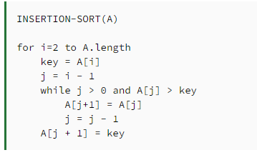
Pseudocode

Slide 66
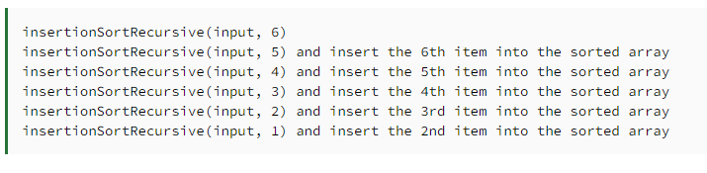
Call Stack

Slide 67
Merge Sort

Slide 68



Merge Sort
Split
Split the array into sub-arrays of a single item
Compare
Compare the individual items
Merge
Merge the items into a sorted array

Slide 69
Merge Sort
Split
6 | 4 | 3 | 7 | 5 | 4 | 8 | 2

Slide 70
Merge Sort
Split
6 | 4 | 3 | 7
5 | 4 | 8 | 2

Slide 71
Merge Sort
Split
6
4
3
7
5
4
8
2

Slide 72
Merge Sort
Split
6
4
3
7
5
4
8
2

Slide 73
Merge Sort
Split
Compare
6
4
3
7
5
4
8
2

Slide 74
Merge Sort
4
Split
Compare
Merge
6
3
7
5
4
8
2

Slide 75
Merge Sort
Split
Compare
Merge
4
6
3
7
5
4
8
2

Slide 76
Merge Sort
Split
Compare
Merge
4
6
3
7
5
4
8
2

Slide 77
Merge Sort
Split
Compare
Merge
4
6
3
7
5
4
8
2

Slide 78
Merge Sort
4
Split
Compare
Merge
4
6
3
7
5
8
2

Slide 79
Merge Sort
Split
Compare
Merge
4
6
3
7
4
5
8
2

Slide 80
Merge Sort
Split
Compare
Merge
4
6
3
7
4
5
8
2

Slide 81
Merge Sort
2
Split
Compare
Merge
4
6
3
7
4
5
8

Slide 82
Merge Sort
Split
Compare
Merge
4
6
3
7
4
5
2
8

Slide 83
Merge Sort
Split
Compare
Merge
4
6
3
7
4
5
2
8

Slide 84
Merge Sort
Split
Compare
Merge
4
6
3
7
4
5
2
8

Slide 85
Merge Sort
Split
Compare
Merge
4
6
7
4
5
2
8
3

Slide 86
Merge Sort
Split
Compare
Merge
6
7
4
5
2
8
3
4

Slide 87
Merge Sort
Split
Compare
Merge
7
4
5
2
8
3 | 4 | 6

Slide 88
Merge Sort
Split
Compare
Merge
4
5
2
8
3 | 4 | 6 | 7

Slide 89
Merge Sort
Split
Compare
Merge
3 | 4 | 6 | 7
4
5
2
8

Slide 90
Merge Sort
Split
Compare
Merge
3 | 4 | 6 | 7
4
5
8
2

Slide 91
Merge Sort
Split
Compare
Merge
3 | 4 | 6 | 7
5
8
2
4

Slide 92
Merge Sort
Split
Compare
Merge
3 | 4 | 6 | 7
8
2 | 4 | 5

Slide 93
Merge Sort
Split
Compare
Merge
3 | 4 | 6 | 7
2 | 4 | 5 | 8

Slide 94
Merge Sort
Split
Compare
Merge
3 | 4 | 6 | 7
2 | 4 | 5 | 8

Slide 95
Merge Sort
Split
Compare
Merge
3 | 4 | 6 | 7
2 | 4 | 5 | 8

Slide 96
Merge Sort
Split
Compare
Merge
3 | 4 | 6 | 7
4 | 5 | 8
2

Slide 97
Merge Sort
Split
Compare
Merge
4 | 6 | 7
4 | 5 | 8
2
3

Slide 98
Merge Sort
Split
Compare
Merge
6
7
4 | 5 | 8
2 | 3 | 4

Slide 99
Merge Sort
Split
Compare
Merge
6
7
5
8
2 | 3 | 4 | 4

Slide 100
Merge Sort
Split
Compare
Merge
6
7
8
2 | 3 | 4 | 4 | 5

Slide 101
Merge Sort
Split
Compare
Merge
7
8
2 | 3 | 4 | 4 | 5 | 6

Slide 102
Merge Sort
Split
Compare
Merge
8
2 | 3 | 4 | 4 | 5 | 6 | 7

Slide 103
Merge Sort
Split
Compare
Merge
2 | 3 | 4 | 4 | 5 | 6 | 7 | 8

Slide 104
Merge Sort
Split
Compare
Merge
2 | 3 | 4 | 4 | 5 | 6 | 7 | 8

Slide 105
Merge Sort
6 | 4 | 3 | 7 | 5 | 4 | 8 | 2
6 | 4 | 3 | 7
5 | 4 | 8 | 2
Split
6
4
3
7
5
4
8
2
6
4
3
7
5
4
8
2
4
6
3
7
4
5
2
8
Compare and Merge
3 | 4 | 6 | 7
2 | 4 | 5 | 8
2 | 3 | 4 | 4 | 5 | 6 | 7 | 8

Slide 106
Merge Sort Asymptotic Analysis
Best O(n log n)
comparisons and swaps
Average O(n log n)
comparisons and swaps
Worst O(n log n)
comparisons and swaps

Slide 107
Merge sort has uniform algorithmic complexity in the worse, average, and best case

Slide 108

Merge Sort Properties
Divide and Conquer
Reduces the problem down to the most basic form
Memory Requirements
Requires O(n) additional memory
Stable Equal items retain
their relative position

Slide 109
Assisted Practice
Merge sort algorithm

Slide 110
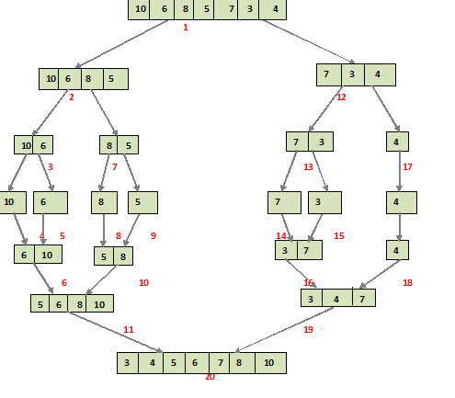

Slide 111
Quicksort

Slide 112



Quicksort
Pivot
Pick the pivot value in the array
Partition
Reorder the elements around the pivot point
Repeat Repeat for each
partition

Slide 113
Quicksort
Pivot
Pick the pivot value in the array
Partition
Reorder the elements around the pivot point
Repeat Repeat for each
partition

Slide 114
What is a pivot value?

Slide 115
Pivot Value
A value in the array where all the values to the left of the pivot are less than (or equal to) the pivot value, and all the values to the right are greater.

Slide 116



Selecting a Pivot Value
Select a random array item
Select the first or last array item
Select the median of the first, last, and middle items

Slide 117
First Value
9 | 6 | 4 | 3 | 8 | 5 | 4 | 1 | 2 | 6

Slide 118
First Value
9 | 6 | 4 | 3 | 8 | 5 | 4 | 1 | 2 | 6

Slide 119
First Value
1 | 2 | 3 | 4 | 4 | 5 | 6 | 6 | 8 | 9
Requires O(n²) operations in the pre-sorted case

Slide 120
Random Value
9 | 6 | 4 | 3 | 8 | 5 | 4 | 1 | 2 | 6

Slide 121
Random Value
9 | 6 | 4 | 3 | 8 | 5 | 4 | 1 | 2 | 6

Slide 122
Median of Three
9 | 6 | 4 | 3 | 8 | 5 | 4 | 1 | 2 | 6

Slide 123
Median of Three
9 | 6 | 4 | 3 | 8 | 5 | 4 | 1 | 2 | 6

Slide 124
Median of Three
9 | 6 | 4 | 3 | 8 | 5 | 4 | 1 | 2 | 6

Slide 125
Quicksort
Pivot
Pick the pivot value in the array
Partition
Reorder the elements around the pivot point
Repeat Repeat for each
partition

Slide 126
Partition
9 | 6 | 4 | 3 | 8 | 5 | 4 | 1 | 2 | 6

Slide 127
Partition
9 | 6 | 4 | 3 | 8 | 5 | 4 | 1 | 2 | 6
Pivot Value (Random)

Slide 128
Partition
2 | 1 | 4 | 4 | 3 | 5 | 6 | 9 | 6 | 8
Less than pivot value
Greater than pivot value

Slide 129
Partition
9 | 6 | 4 | 3 | 8 | 5 | 4 | 1 | 2 | 6

Slide 130
Partition
9 | 6 | 4 | 3 | 8 | 5 | 4 | 1 | 2 | 6
Pivot Value

Slide 131
Partition
9 | 6 | 4 | 3 | 8 | 5 | 4 | 1 | 2 | 6

Slide 132
Partition
9
6 | 4 | 3 | 8 | 5 | 4 | 1 | 2 | 6

Slide 133
Partition
6 | 4 | 3 | 8 | 5 | 4 | 1 | 2 | 6 | 9

Slide 134
Partition
6 | 4 | 3 | 8 | 5 | 4 | 1 | 2 | 6 | 9

Slide 135
Partition
6
4 | 3 | 8 | 5 | 4 | 1 | 2 | 6 | 9

Slide 136
Partition
6
4 | 3 | 8 | 5 | 4 | 1 | 2 | 6 | 9

Slide 137
Partition
4 | 3 | 8 | 5 | 4 | 1 | 2 | 6 | 9 | 6

Slide 138
Partition
4 | 3 | 8 | 5 | 4 | 1 | 2 | 6 | 9 | 6

Slide 139
Partition
4 | 3 | 8 | 5 | 4 | 1 | 2 | 6 | 9 | 6

Slide 140
Partition
4 | 3 | 8 | 5 | 4 | 1 | 2 | 6 | 9 | 6

Slide 141
Partition
8
4
3
5 | 4 | 1 | 2 | 6 | 9 | 6

Slide 142
Partition
8
4 | 3 | 5 | 4 | 1 | 2 | 6 | 9 | 6

Slide 143
Partition
4 | 3 | 5 | 4 | 1 | 2 | 6 | 9 | 6 | 8

Slide 144
Partition
4 | 3 | 5 | 4 | 1 | 2 | 6 | 9 | 6 | 8

Slide 145
Partition
4
4 | 3 | 5
1 | 2 | 6 | 9 | 6 | 8

Slide 146
Partition
4 | 4 | 3 | 5 | 1 | 2 | 6 | 9 | 6 | 8

Slide 147
Partition
4 | 4 | 3 | 5 | 1 | 2 | 6 | 9 | 6 | 8

Slide 148
Partition
1
4 | 4 | 3 | 5
2 | 6 | 9 | 6 | 8

Slide 149
Partition
1 | 4 | 4 | 3 | 5 | 2 | 6 | 9 | 6 | 8

Slide 150
Partition
1 | 4 | 4 | 3 | 5 | 2 | 6 | 9 | 6 | 8

Slide 151
Partition
2
1 | 4 | 4 | 3 | 5
6 | 9 | 6 | 8

Slide 152
Partition
2
1 | 4 | 4 | 3 | 5 | 6 | 9 | 6 | 8

Slide 153
Partition
2 | 1 | 4 | 4 | 3 | 5 | 6 | 9 | 6 | 8

Slide 154
Partition
2 | 1 | 4 | 4 | 3 | 5 | 6 | 9 | 6 | 8

Slide 155
Partition
2 | 1 | 4 | 4 | 3 | 5 | 6 | 9 | 6 | 8

Slide 156
Partition
2 | 1 | 4 | 4 | 3 | 5 | 6 | 9 | 6 | 8
Less than pivot
Greater than pivot

Slide 157

Partition
2 | 1 | 4 | 4 | 3 | 5 | 6 | 9 | 6 | 8
Less than pivot
Greater than pivot

Slide 158
Quicksort
Pivot
Pick the pivot value in the array
Partition
Reorder the elements around the pivot point
Repeat Repeat for each
partition

Slide 159
Repeat
2 | 1 | 4 | 4 | 3 | 5 | 6 | 9 | 6 | 8

Slide 160
Repeat
2 | 1 | 4 | 4 | 3 | 5 | 6 | 9 | 6 | 8

Slide 161
Repeat
1 | 2 | 4 | 4 | 3 | 5 | 6 | 9 | 6 | 8

Slide 162
Repeat
1 | 2 | 4 | 4 | 3 | 5 | 6 | 9 | 6 | 8

Slide 163
Repeat
1 | 2 | 4 | 4 | 3 | 5 | 6 | 9 | 6 | 8

Slide 164
Repeat
1 | 2 | 4 | 4 | 3 | 5 | 6 | 9 | 6 | 8

Slide 165
Repeat
1 | 2 | 4 | 4 | 3 | 5 | 6 | 9 | 6 | 8

Slide 166
Repeat
1 | 2 | 3 | 4 | 4 | 5 | 6 | 9 | 6 | 8

Slide 167
Repeat
1 | 2 | 3 | 4 | 4 | 5 | 6 | 9 | 6 | 8

Slide 168
Repeat
1 | 2 | 3 | 4 | 4 | 5 | 6 | 9 | 6 | 8

Slide 169
Repeat
1 | 2 | 3 | 4 | 4 | 5 | 6 | 9 | 6 | 8

Slide 170
Repeat
1 | 2 | 3 | 4 | 4 | 5 | 6 | 9 | 6 | 8

Slide 171
Repeat
1 | 2 | 3 | 4 | 4 | 5 | 6 | 9 | 6 | 8

Slide 172
Repeat
1 | 2 | 3 | 4 | 4 | 5 | 6 | 9 | 6 | 8

Slide 173
Repeat
1 | 2 | 3 | 4 | 4 | 5 | 6 | 6 | 8 | 9

Slide 174
Repeat
1 | 2 | 3 | 4 | 4 | 5 | 6 | 6 | 8 | 9

Slide 175
Repeat
1 | 2 | 3 | 4 | 4 | 5 | 6 | 6 | 8 | 9

Slide 176
Repeat
1 | 2 | 3 | 4 | 4 | 5 | 6 | 6 | 8 | 9

Slide 177
Repeat
1 | 2 | 3 | 4 | 4 | 5 | 6 | 6 | 8 | 9

Slide 178
Repeat
1 | 2 | 3 | 4 | 4 | 5 | 6 | 6 | 8 | 9

Slide 179
Repeat
1 | 2 | 3 | 4 | 4 | 5 | 6 | 6 | 8 | 9

Slide 180
Repeat
1 | 2 | 3 | 4 | 4 | 5 | 6 | 6 | 8 | 9

Slide 181
Repeat
1 | 2 | 3 | 4 | 4 | 5 | 6 | 6 | 8 | 9

Slide 182
Quicksort Asymptotic Analysis
Best O(n log n)
comparisons and swaps
Average O(n log n)
comparisons and swaps
Worst
O(n²) comparisons and swaps

Slide 183
Quicksort Properties
Divide and Conquer
Reduces the problem down to the most basic form
In-place Requires only O(log n)
additional memory
Optimizable
There exist many optimizations to improve performance

Slide 184
Quicksort is the default sorting algorithm for many programming languages

Slide 185
Assisted Practice
Quicksort algorithm

Slide 186
Selection Sort

Slide 187
Selection Sort
selection sort: Orders a list of values by repeatedly putting the smallest or largest unplaced value into its final position.
The algorithm:
Look through the list to find the smallest value.
Swap it so that it is at index 0.
Look through the list to find the second-smallest value.
Swap it so that it is at index 1.
...
Repeat until all values are in their proper places.

Slide 188
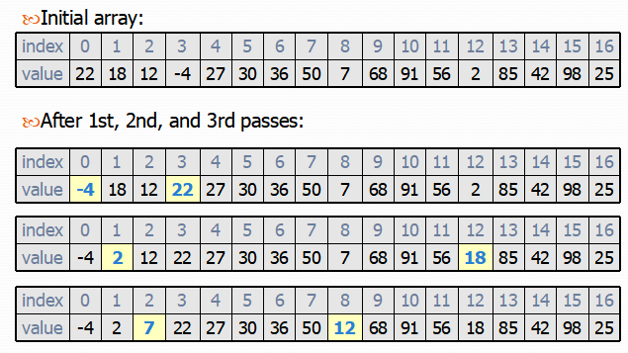
Selection Sort in action

Slide 189
Assisted Practice
Selection Sort algorithm

Slide 190
Array Searching Algorithms

Slide 191
Linear Search

Slide 192
4 | 9 | 3 | 11 | 2 | 1 | 13 | 5
Linear Search
Scan the array, from start to end, comparing each array item against the value being sought.

Slide 193
4 | 9 | 3 | 11 | 2 | 1 | 13 | 5
Linear Search
Scan the array, from start to end, comparing each array item against the value being sought.

Slide 194
4 | 9 | 3 | 11 | 2 | 1 | 13 | 5
Linear Search
Scan the array, from start to end, comparing each array item against the value being sought.

Slide 195
4 | 9 | 3 | 11 | 2 | 1 | 13 | 5
Linear Search
Scan the array, from start to end, comparing each array item against the value being sought.

Slide 196
4 | 9 | 3 | 11 | 2 | 1 | 13 | 5
Linear Search
Scan the array, from start to end, comparing each array item against the value being sought.

Slide 197
public bool Search(int[] data, int value) {
for(int i = 0; | i < data.Length; | i++) | {
if(data[i] return | == value) { true;
}
}
return false;
}
Linear Search
Scan the array, from start to end, comparing each array item against the value being sought.

Slide 198
Linear search performance
O(n)
Linear searching must examine each array item until the value is found giving it O(n) algorithmic complexity.

Slide 199
Assisted Practice
Linear Search algorithm

Slide 200
Binary Search

Slide 201
4 | 9 | 3 | 11 | 2 | 1 | 13 | 5
Binary Search
Starting with a sorted array, check the middle array value. If the value is a match, then the value has been found. If the value is greater than the sought value, repeat this process for the values to the left, otherwise for the values to the right.

Slide 202
1 | 2 | 3 | 4 | 5 | 9 | 11 | 13
Binary Search
Starting with a sorted array, check the middle array value. If the value is a match, then the value has been found. If the value is greater than the sought value, repeat this process for the values to the left, otherwise for the values to the right.

Slide 203
1 | 2 | 3 | 4 | 5 | 9 | 11 | 13
Binary Search
Starting with a sorted array, check the middle array value. If the value is a match, then the value has been found. If the value is greater than the sought value, repeat this process for the values to the left, otherwise for the values to the right.

Slide 204
1 | 2 | 3 | 4 | 5 | 9 | 11 | 13
Binary Search
Starting with a sorted array, check the middle array value. If the value is a match, then the value has been found. If the value is greater than the sought value, repeat this process for the values to the left, otherwise for the values to the right.

Slide 205
1 | 2 | 3 | 4 | 5 | 9 | 11 | 13
Binary Search
Starting with a sorted array, check the middle array value. If the value is a match, then the value has been found. If the value is greater than the sought value, repeat this process for the values to the left, otherwise for the values to the right.

Slide 206
1 | 2 | 3 | 4 | 5 | 9 | 11 | 13
Binary Search
Starting with a sorted array, check the middle array value. If the value is a match, then the value has been found. If the value is greater than the sought value, repeat this process for the values to the left, otherwise for the values to the right.

Slide 207
1 | 2 | 3 | 4 | 5 | 9 | 11 | 13
Binary Search
Starting with a sorted array, check the middle array value. If the value is a match, then the value has been found. If the value is greater than the sought value, repeat this process for the values to the left, otherwise for the values to the right.

Slide 208
1 | 2 | 3 | 4 | 5 | 9 | 11 | 13
Binary Search
Starting with a sorted array, check the middle array value. If the value is a match, then the value has been found. If the value is greater than the sought value, repeat this process for the values to the left, otherwise for the values to the right.

Slide 209
1 | 2 | 3 | 4 | 5 | 9 | 11 | 13
Binary Search
Starting with a sorted array, check the middle array value. If the value is a match, then the value has been found. If the value is greater than the sought value, repeat this process for the values to the left, otherwise for the values to the right.

Slide 210
public bool Search(int[] data, int value) { int start = 0;
int end = data.Length - 1;
◀ Record the start and end of the range we are searching (starts with the entire array)
while (start <= end) {
int middle = (start + end) / 2;
◀ While we have unsearched area
◀ Pick the middle item of the search range
if (data[middle] == value) return true;
else if (data[middle] < value) start = middle + 1;
else
end = middle - 1;
◀ If we found our value return true
◀ If the value is greater than the array index…
◀ Cut the range in half by increasing start
◀ Else cut the range in half by decreasing end
}
return false;
◀ We did not find the value so return false
}

Slide 211
Binary search performance
O(log n)
Binary search is a divide-and- conquer algorithm giving it O(log n) algorithmic complexity.

Slide 212
Assisted Practice
Binary Search algorithm

Slide 213
Exponential Search

Slide 214
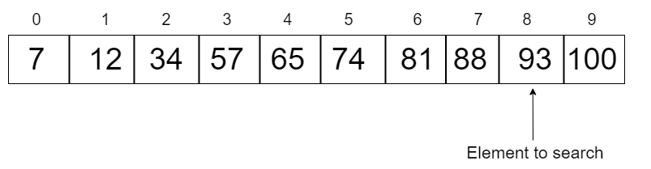

Slide 215
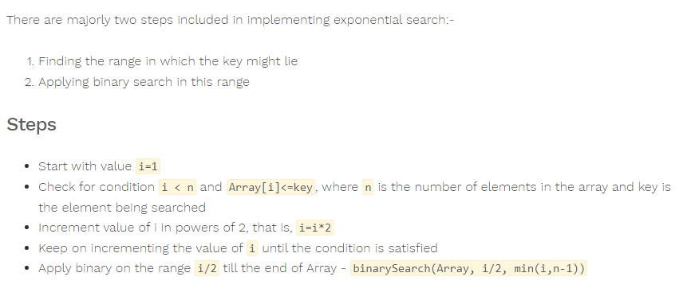
Exponential Search Algorithm

Slide 216
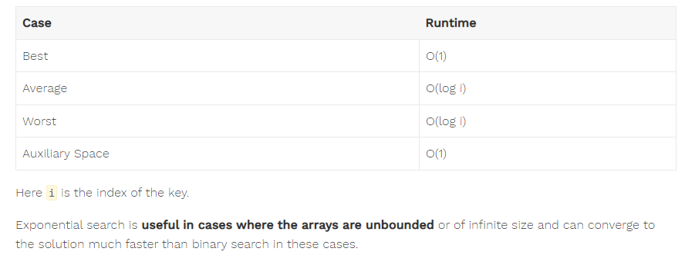
Performance

Slide 217
Assisted Practice
Exponential Search algorithm

Slide 218
Graphs

Slide 219
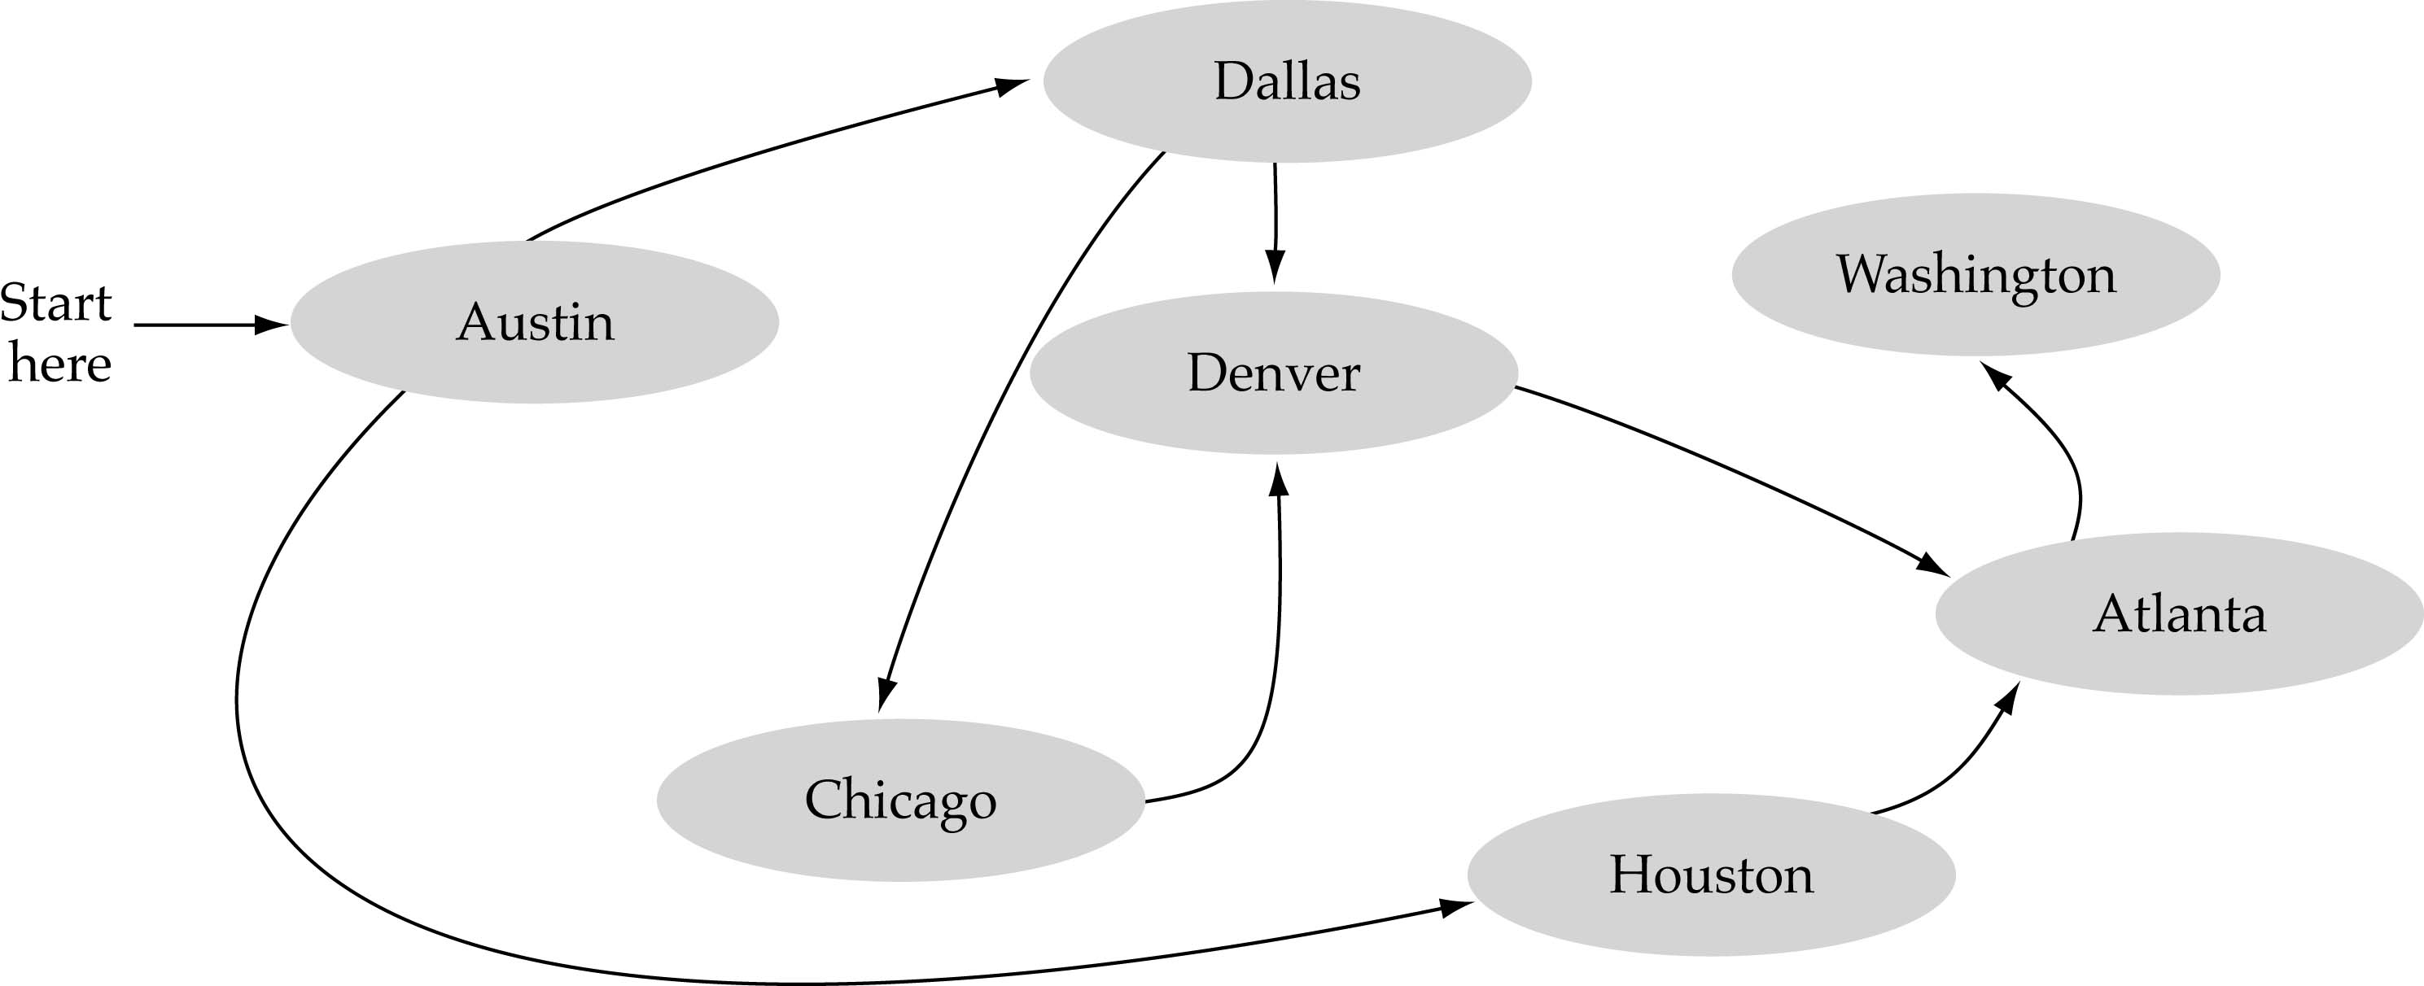
What is a graph?
A data structure that consists of a set of nodes (vertices) and a set of edges that relate the nodes to each other
The set of edges describes relationships among the vertices

Slide 220
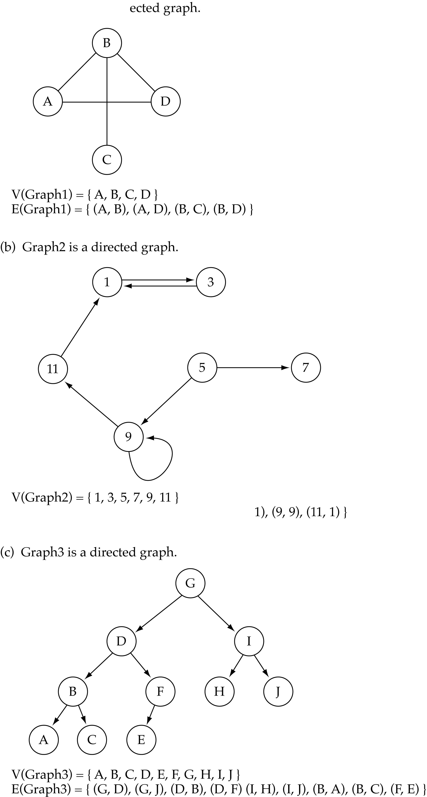
Directed vs. undirected graphs
When the edges in a graph have no direction, the graph is called undirected

Slide 221
Directed vs. undirected graphs (cont.)
When the edges in a graph have a direction, the graph is called directed (or digraph)
Warning: if the graph is directed, the order of the vertices in each edge is important !!
E(Graph2) = {(1,3) (3,1) (5,9) (9,11) (5,7)

Slide 222
Graph terminology
Adjacent nodes: two nodes are adjacent if they are connected by an edge
Path: a sequence of vertices that connect two nodes in a graph
Complete graph: a graph in which every vertex is directly connected to every other vertex
5 is adjacent to 7
7 is adjacent from 5

Slide 223
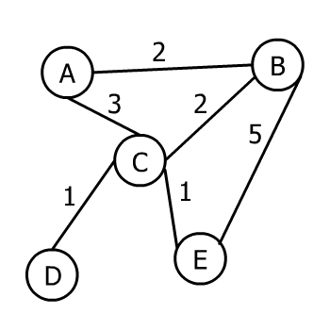
Minimum Spanning Tree and Prim’s Algorithm

Slide 224
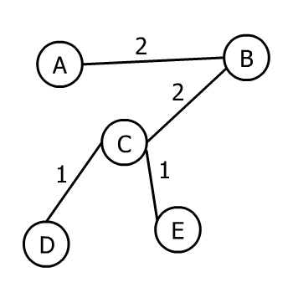

Slide 225
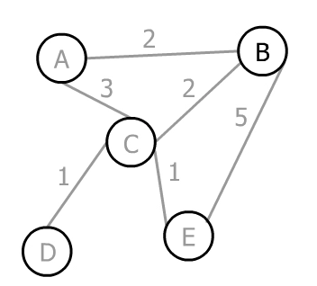
Prim's Algorithm

Slide 226
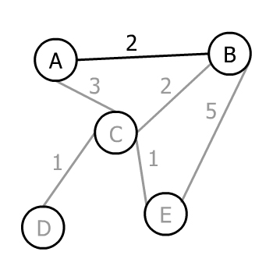

Slide 227
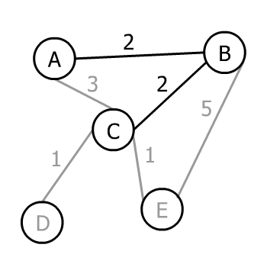

Slide 228
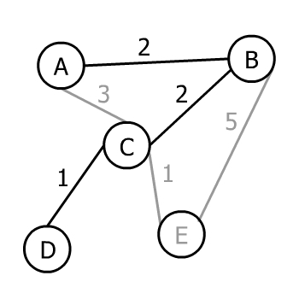

Slide 229
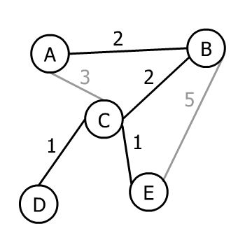

Slide 230
Assisted Practice
Minimum Spanning Tree

Slide 231
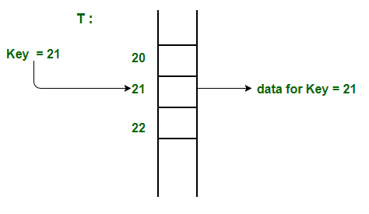
Index Mapping (or Trivial Hashing)

